Slide 1


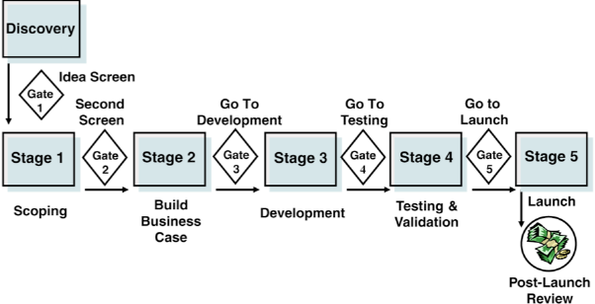
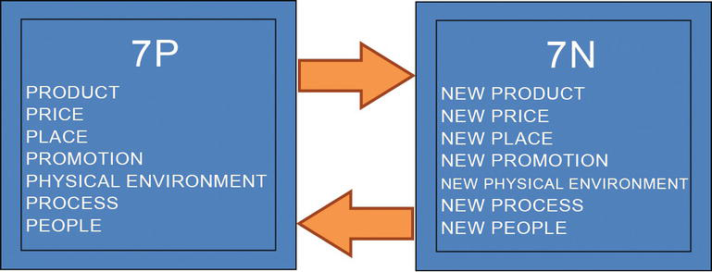
DHL TRANSPORT PROJECT; CONVEYING PEOPLE TO THEIR DESTINATION
The project
Benefits of the products to the DHL
Dalsey Hillblom Lynn (DHL), a German logistics company, is among the top logistics companies worldwide delivering billions of parcels yearly (DHL, 2022). It was founded by three people Adrian Dalsey, Larry Hillblom and Robert Lynn, in San Fransisco in the United States in1969 (Scurlock, 2012), whose names were used for the company. The company provides courier, packaging delivery and express mail services. Due to their success in the logistics and transportation of goods, this project aims to introduce the transport of people as a new product for the company. This project aims to utilise the integrity of the company to maximise profit.
SWOT ANALYSIS
(Karingithi, 2012; Liu and Wen, 2012; Projects4MBA, 2022)
Strength -
Brand Partnership
Experienced workforce
Range of products
Strong financial record
Customer trust
Trademark and patent
Globalisation and worldwide services
Investments in developing countries
Weakness –
Policy compliance
Service delivery
Pricing strategy
Marketing
Opportunities
Acquisition of local players for expansion
Expansion to E-commerce companies
Supply chain
Transportation of people
Digitalisation
Threat
Competition by major logistics players like Fedx and UPS
Local players
Government policies
Natural disasters and adverse economy
Increased market share.
Increased profit margin.
Improve Customer satisfaction.
Improve brand image.
Improve competitive advantage.
Stage gate theory
The stage gate theory, a five-stage model including the discovery stage, will be adopted to ensure a successful project. The model involves an evaluation phase (the gate) after each stage which serves as a decision point on whether the project should continue (Cooper, 2022). The model is suitable for new products such as the transport project. According to the theory, either Go, Kill, Hold or recycle decision will be made after each gate.
The Stage gate theory (Cooper, 2022)
Marketing mix
Idea generation
Idea screening
Concept development and testing
Marketing strategy development
Business analysis
Product development
Market testing
Product commercialization
Marketing is important for new products; despite the significance of the company in the transport industry, it is necessary to create awareness about the new product to the target market. It is important to emphasise the significance of managing the innovation process in marketing by referring to the 7P mix, which classifies marketing's fundamental strategies and techniques into seven major categories, as the 7 N. The 7ps and 7Ns interact with one another in a way that propels marketing. Management and implementation of the marketing mix components are crucial for dealing with new products, new prices, new places, new promotions, new physical environments, new processes and new people.
Stages involved in the development of a new product
Challenges and risks associated with the product
Based on the SWOT analysis, it is evident that pricing is a challenge that DHL can face, as it shares its customers with local players who provide these services at a lower cost.
They are also at risk of compliance with government policies and regulations.
Weather conditions
Financial implications
Marketing mix (Gurbuz, 2018)

Slide 2
References
Cooper, R.G., 2022. The Stage-Gate system for product innovation in B2B firms. In Handbook of business-to-business marketing (pp. 533-561). Edward Elgar Publishing.
DHL (2022). Logistics for the connected age. Available at: https://www.dhl.com/global-en/home/about-us.html. [Accessed on 24 November 2022].
Gurbuz, E., 2018. Theory of new product development and its applications. Marketing, pp.57-75.
Karingithi, M.G., 2012. Strategic management practices at DHL Global Gorwarding Kenya Limited (Doctoral dissertation, University of Nairobi).
Liu, J. and Wen, Y., 2012. Study of Competitiveness: A Case Study of DHL.
Projects4MBA, 2020 SWOT Analysis of DHL [Step by Step SWOT]., Available at: <https://www.projects4mba.com/swot-analysis-of-dhl/4965/> [Accessed on 24 November 2022].
Scurlock, J.D., 2012. King Larry: The Life and Ruins of a Billionaire Genius. Simon and Schuster.

